Slide 1

Ibm data science
Capstone Project
GEOSPATIAL ANALYSIS OF SHEFFIELD, UNITED KINGDOM

Slide 2
Introduction
I wish to create a model/tool which enable people who are thinking of moving to and or opening a business in Sheffield, UK.
Sheffield is a city in the north east of the England, in the county of south Yorkshire. It is famously a heavy industrial city but has begun recently changing into a city of multi economic sources. There have been significant changes to areas across the city in recent years. Specifically, with the adoption of small enterprises being favoured by residents over large brands.
In this particular example of the report a person is wanting to open a coffee shop in Sheffield, they will need to now the areas that are already saturated with coffee shops and the areas that are in place for a new coffee shop.

Slide 3
Data
What data sources will I need access to and what packages will I be using
Geospatial data to identify where Sheffield is, and where its areas/postcodes are. Postcode.csv is from the royal mail data portal it contains the high-level postcodes for Sheffield with the corresponding geo coordinates
Foursquare API in order to identify what kind of facilities are in each area.
Pandas, NumPy, Sklearn, Geopy, Folium
I will be using Pandas to import the geodata and the cleanse it into a usable format. Ready to be analysed using Sklearn and the plotting using Numpy.

Slide 4
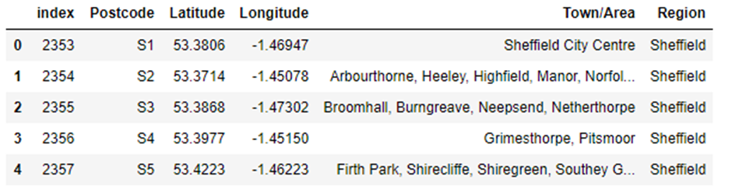
Methodology
Post Code data imported from csv file, then cleaned using Pandas

Slide 5
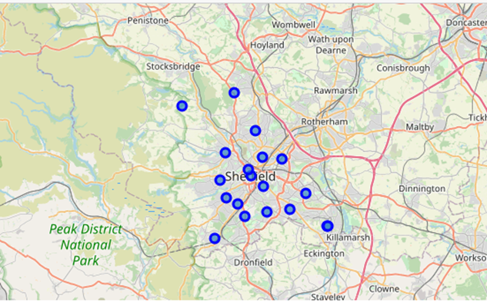
Methodology
The post codes are then plotted on a map to give an example of where the post codes are located

Slide 6
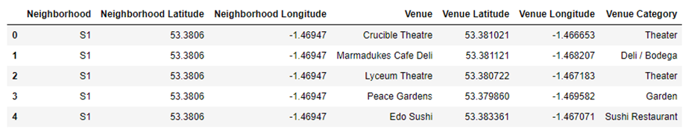
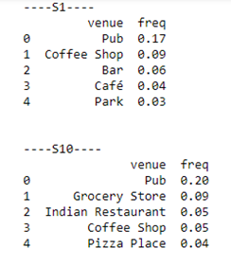
Methodology
A list of venues are then downloaded using the Four Square api, for each area and stored in each table
Then using a one hot matrix we were able to apply that to the neighbourhoods to see the %frequency of each venue type.

Slide 7
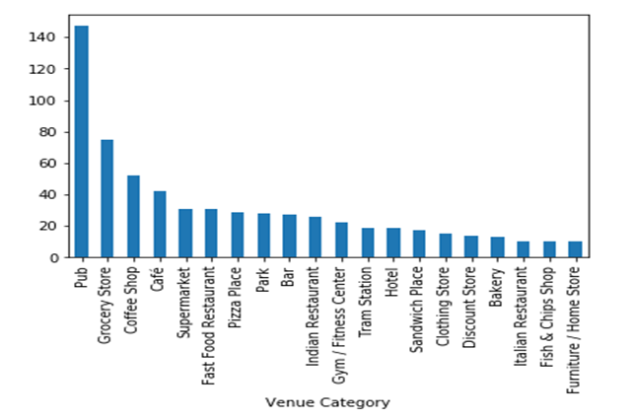
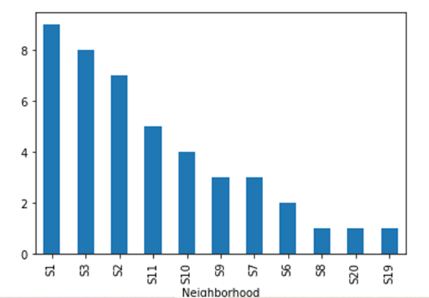
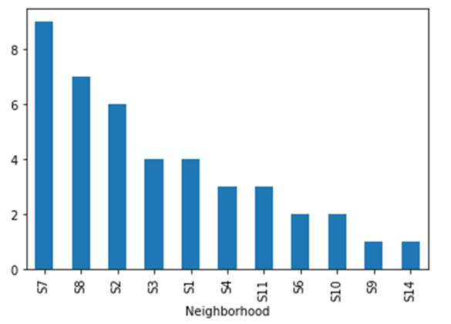
RESULTS
Initial analysis quickly shows which are top 20 venue categories in the Sheffield. Here we can see that Pubs are the biggest number with ~145 of them. Coffee shops are in third with ~50 of them.
Coffee Shops
Cafes

Slide 8
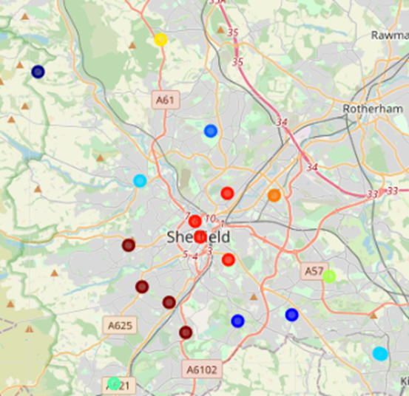
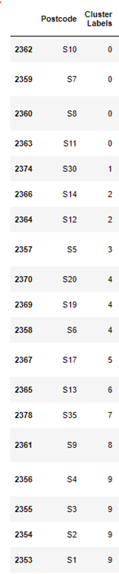
RESULTS
apply the kmeans to the data to see how the group together. The table and map below show the post codes, and which cluster the apply to.

Slide 9
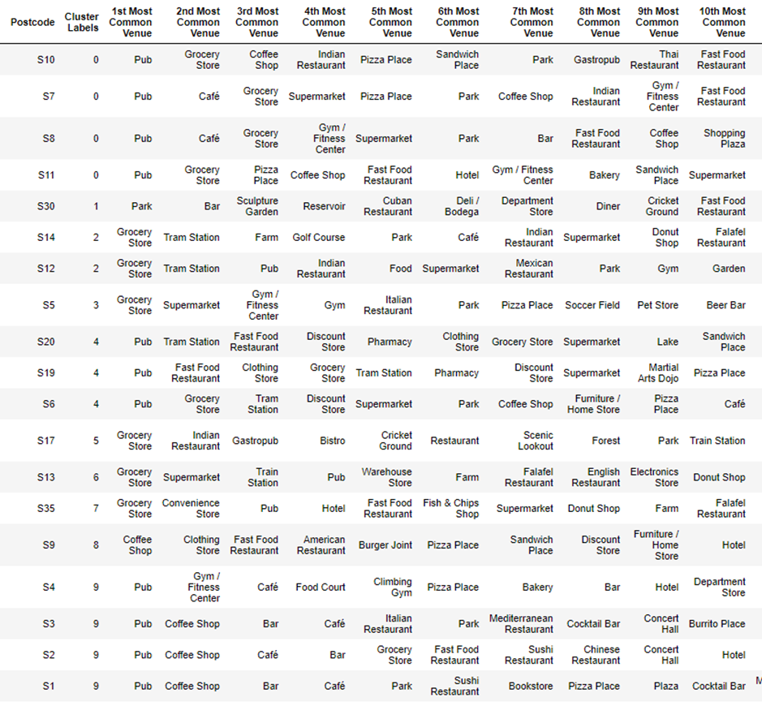
RESULTS
From this list combined with the previous charts we will be able to recommend an area to where to open a coffee shop

Slide 10
DISCUSION
As mentioned, before we are looking for a place to open a coffee shop in Sheffield. It is important to remember that in the UK there is little difference between cafes and coffee shops. From the previous graphs we could see that S1, S2, S3, S7 and S8 have the most cafes and coffee shops. There fore these areas would not the best place to open a coffee shop as they are already saturated.
From previous knowledge know that areas in the 0 cluster have the heights amount of disposable income in the city. So we should look at these areas for opening the new coffee shop. Using the table above, with k-means results in we van choose the area in cluster 0 with coffee shop /café low ranking. To this end I recommend opening the shop in post code S10.

Slide 11
CONCLUSIONS & RECOMNEDATIONS
So we would recommend that the client opens there coffee shop in the post code S10.
Let’s talk about some caveats, this analysis is single dimensional only looking density of venues in each area. In future iterations of this model I would use social economic data to measure the distribution of wealth and available income in the city. Plus the being able to see age demographics will help with the design of coffee shop and its offerings. I would also look at the residential/commercial or industrial ratio in each area. This would help to estimate the potential footfall and when the shop would be busy.

